Slide 1

Package for behavioral experiments in sentences parsing
Prof. Aya Meltzer
Abeer Assy, Sina Kabaha,
Ella Yakir, Chen Levy Arviv
Sagol School of Neuroscience,
Python Hackathon,
August 2024
[Link to repository]

Slide 2
Project Goal
Create a user-friendly interface - GUI that allows researchers to upload their experimental stimuli and make adjustments to the template Java-based code, used to run behavioral experiments in PCIbex platform.

Slide 3
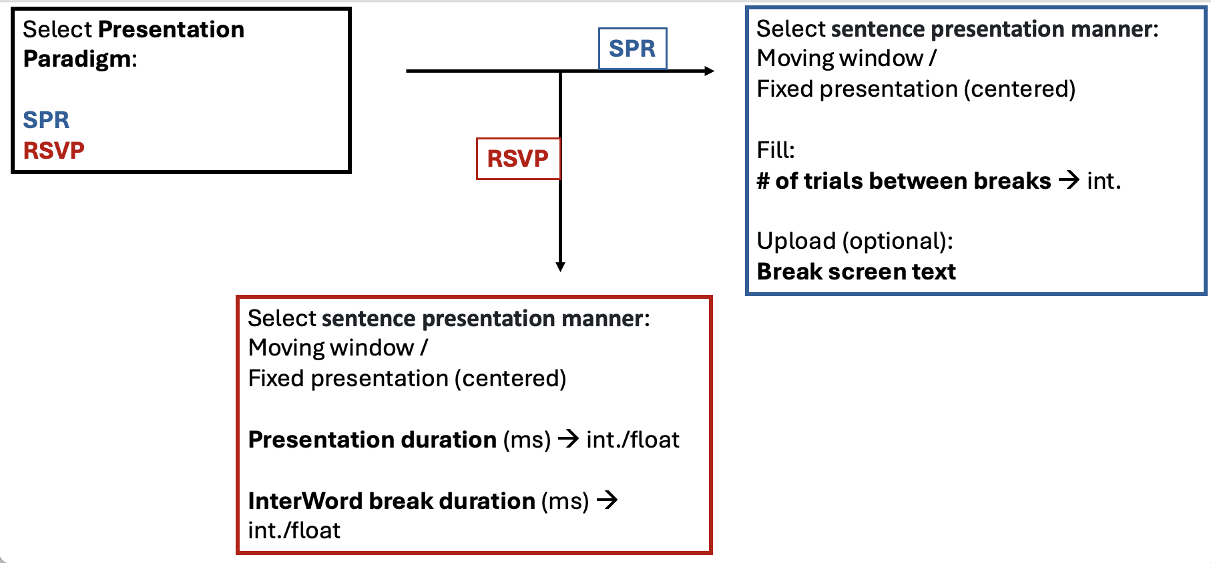
Project Demo
Template java code
GUI flow chart
User instructions
Our Code!!
Final java code

Slide 4
Major Components
Component 1: GUI creation– [Chen Arviv]
Component 2: Input validation [Abeer Assy, Sina Kabaha]
Component 3: Implementation of the User’s input in the JavaScript code [Ella Yakir].

Slide 5
Major Components - Flowchart
GUI
Input validation
Implementation
to the
experimental
script

Slide 6
Data files
The data csv files allow user to access the data:
experimental_file
practice_file
3) Java_template_scripts

Slide 7
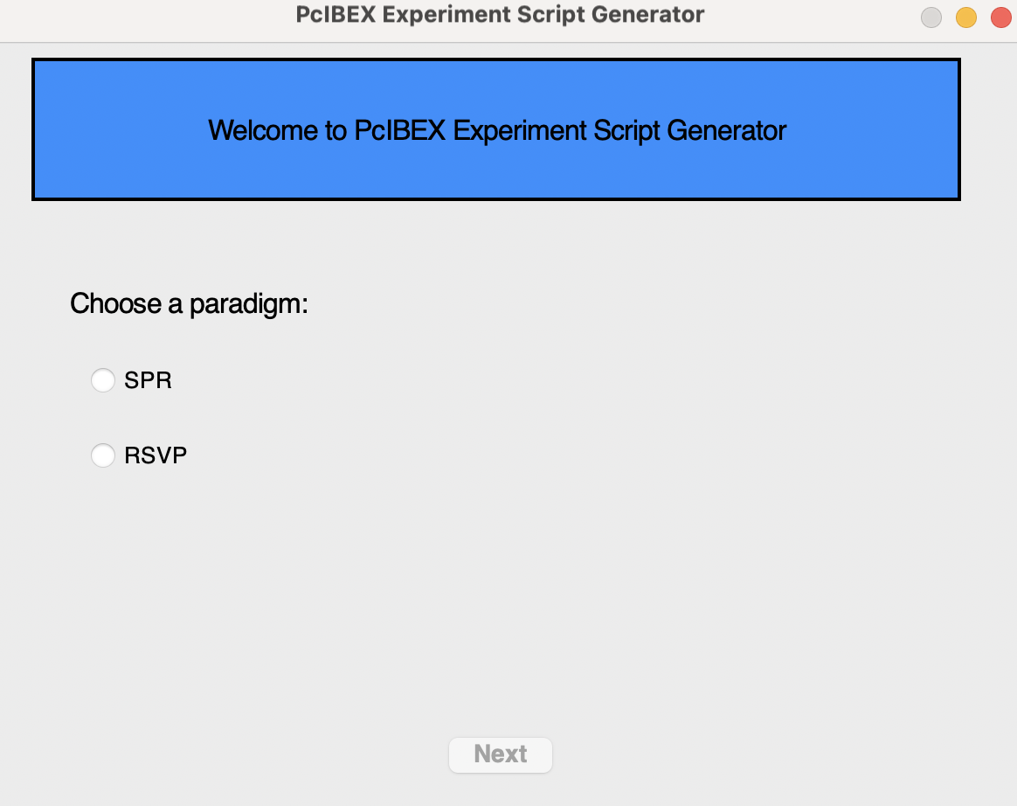
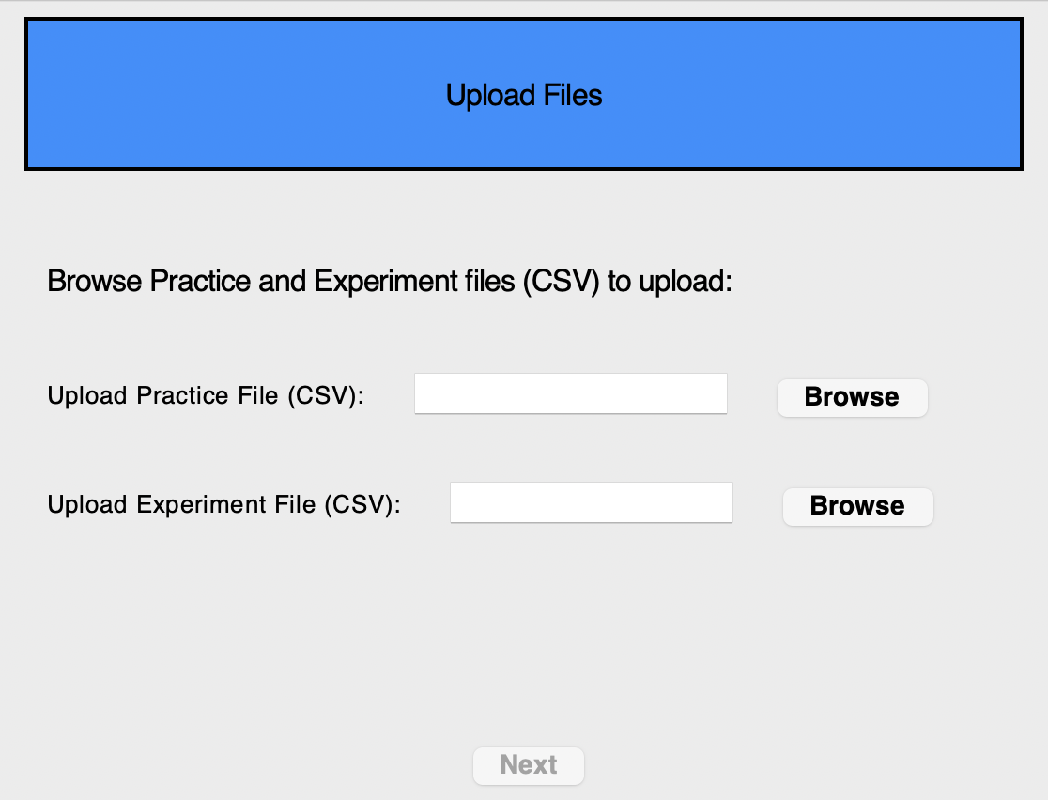
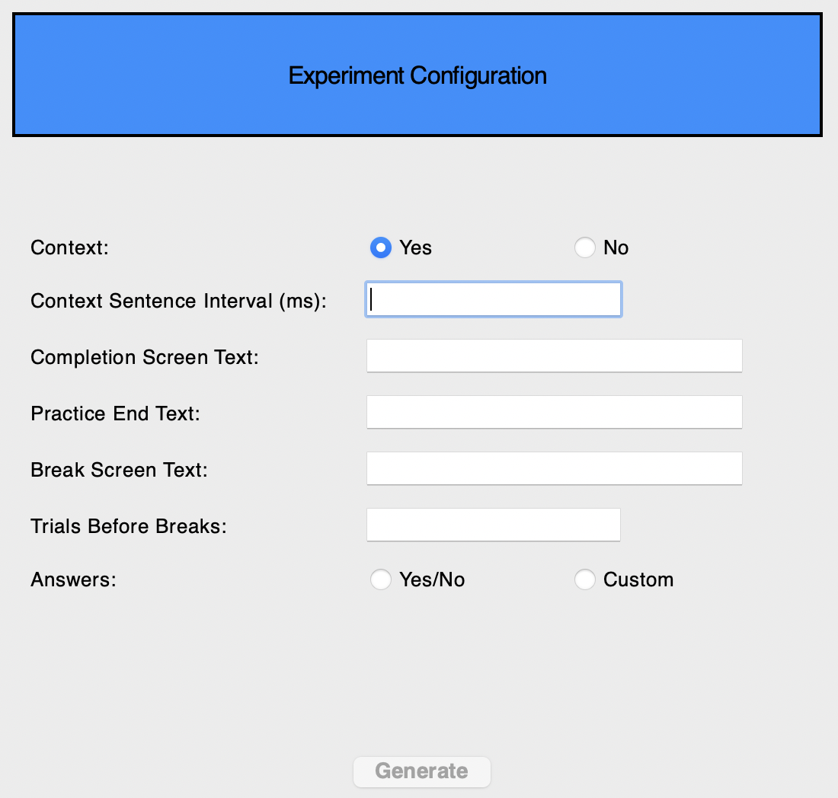
GUI Display

Slide 8
Main Challenges and Difficulties
It was difficult for us (beginners) to create a GUI but using ‘Tkinter’ package makes our life easier!
Creating tests was a little bit challenging!! But we were able at the end to come with some ideas that check the code’s accuracy.
However, checking the last Java script is done by running it in the PCIbex ☺

Slide 9
Concluding Remarks
Is the project usable?
YES, the code will be used in the lab to create final scripts for behavioral linguistic experiments to be run in PCIbex.
What’s left to do?
We created a code that handle 2 experimental paradigms in total but it can be developed to deal with more paradigms based on the lab’s needs → the template is THERE now!!!

Slide 10
Shortly, we had a lot of fun!!!

